Slide 1



How Travel Marketers Should Use GA4
Joseph Dabbs
Jacquelyn Blackwell
Whitney Henley

Slide 2
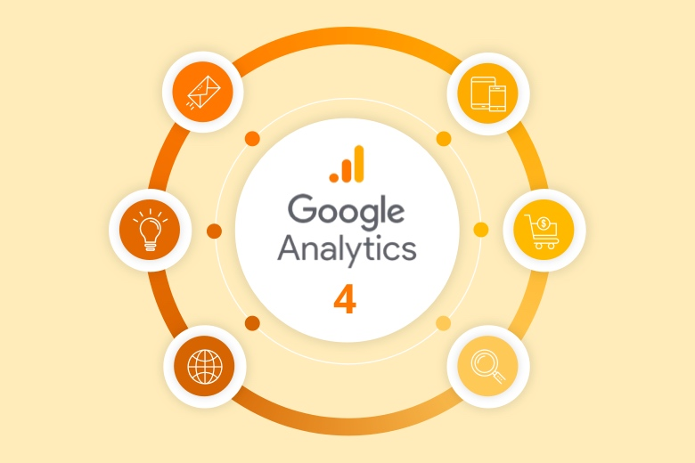
Why GA4?
UA was created primarily as a counter of users.
GA4 is created to monitor user behavior.
Online behavior has evolved an incredible amount since UA was created, and there is
now a need to follow behavior across all
platforms and devices.
There is also a push in the industry for more
opt-in data from users, and with the evolution
of ‘data walls’ for content, GA4 is set to handle
the new flow of information.
GA4 is less of a reporting tool and more
of an analysis engine.

Slide 3
GA4 at its essence
Think about the concept of surveys
If you regularly send out surveys to your audience, then you understand you’ll never get replies back from everyone in your audience.
However, you’ll receive enough data to predict
the likelihood of an outcome and make strategic decisions about the future of your organization.
In much the same way, Google Analytics 4 uses modeling to help you make strategic decisions
about your organization based on the data it collects.
SURVEY DATA
Data
Collection
Data
Analysis

Slide 4
GA4 UTMs—what’s different?
utm_source: Referrer. For example: google, newsletter4, billboard.
utm_medium: Marketing medium. For example: cpc, banner, email.
utm_campaign: Product, slogan, promo code. For example: spring_sale.
utm_content: Use to differentiate creatives. For example: if you have two call-to-action links within the same email message, you can use utm_content and set different values for each so you can tell which version is more effective.
www.gulfshores.com/?utm_source=advance&utm_medium=social&utm_campaign=FacebookInstagram&utm_content=spring
is now
www.gulfshores.com/?utm_source=facebook&utm_medium=paid&utm_campaign=advance_facebook_&utm_content=spring

Slide 5
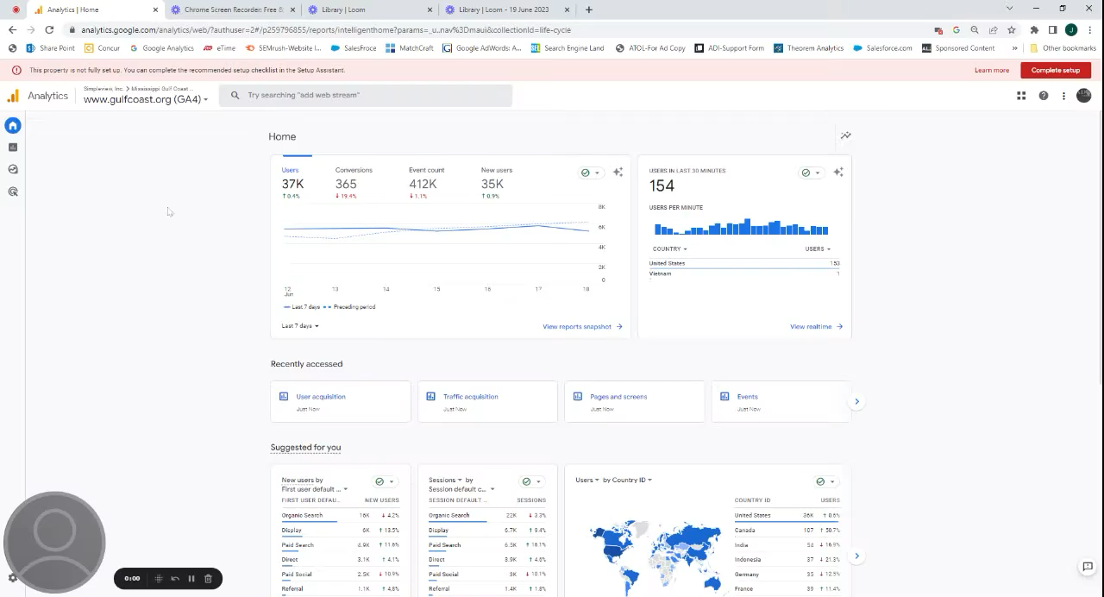
GA4 terminology
Analytics | Home - 19 June 2023 - Watch Video
User acquisition report
Under the Acquisition report heading, you’ll find the user acquisition report. The user acquisition report provides data about how you attracted new users to your site.
Traffic acquisition report
Under the Acquisition report heading, you’ll find the traffic acquisition report. The traffic acquisition report is about sessions, so you’ll see data about all sessions, whether the users are new or returning.

Slide 6

GA4 terminology
Analytics | Home - 14 June 2023 - Watch Video
https://www.loom.com/share/5fe27b8d45db4036b0cf2c58f0d08b7e?sid=1742da20-471e-40ac-a41e-d0bc1acdc6c2
Average engagement time
Google Analytics 4 is very focused on engagement instead of bounce rate (which was a metric in Universal Analytics). Average engagement time replaces the average time on site metric from Universal Analytics.
It just means how long on average user actively spent on your site.

Slide 7
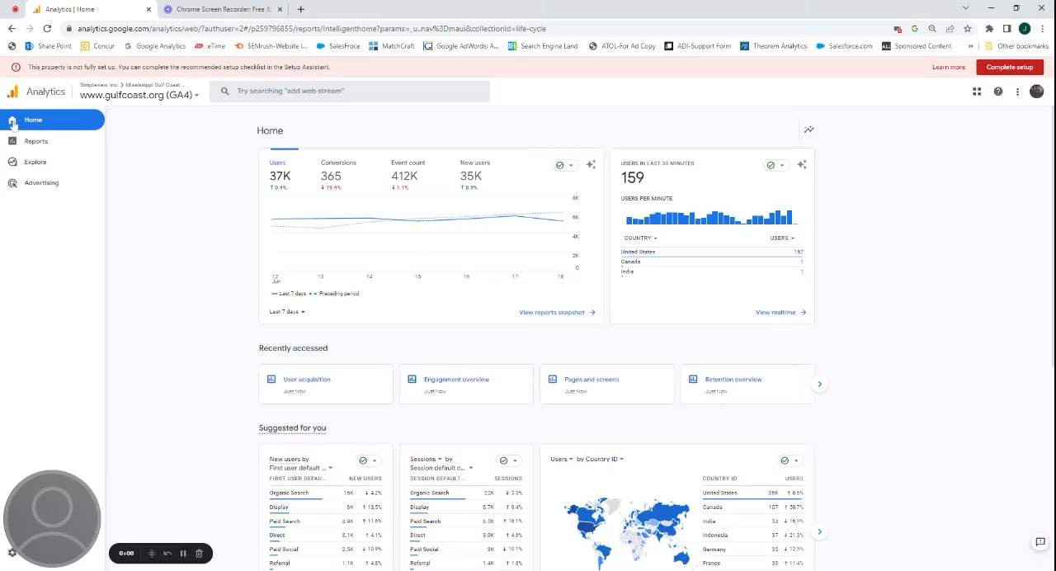
Analytics | Home - 19 June 2023 - Watch Video
GA4 terminology
Engaged Sessions vs. Pages Per Session
How many of your visitors are “engaged” with your site? Google Analytics will count a session as engaged if:
It lasts longer than 10 seconds
It includes at least one conversion
It includes 2 or more page views
Engagement rate vs Bounce Rate
It is the number of engaged sessions divided by the total number of sessions.
Engaged Session Per User
vs Pages Per User
This metric is simply the number of engaged sessions divided by the number of users. The higher the number, the more engaged your audience is.

Slide 8
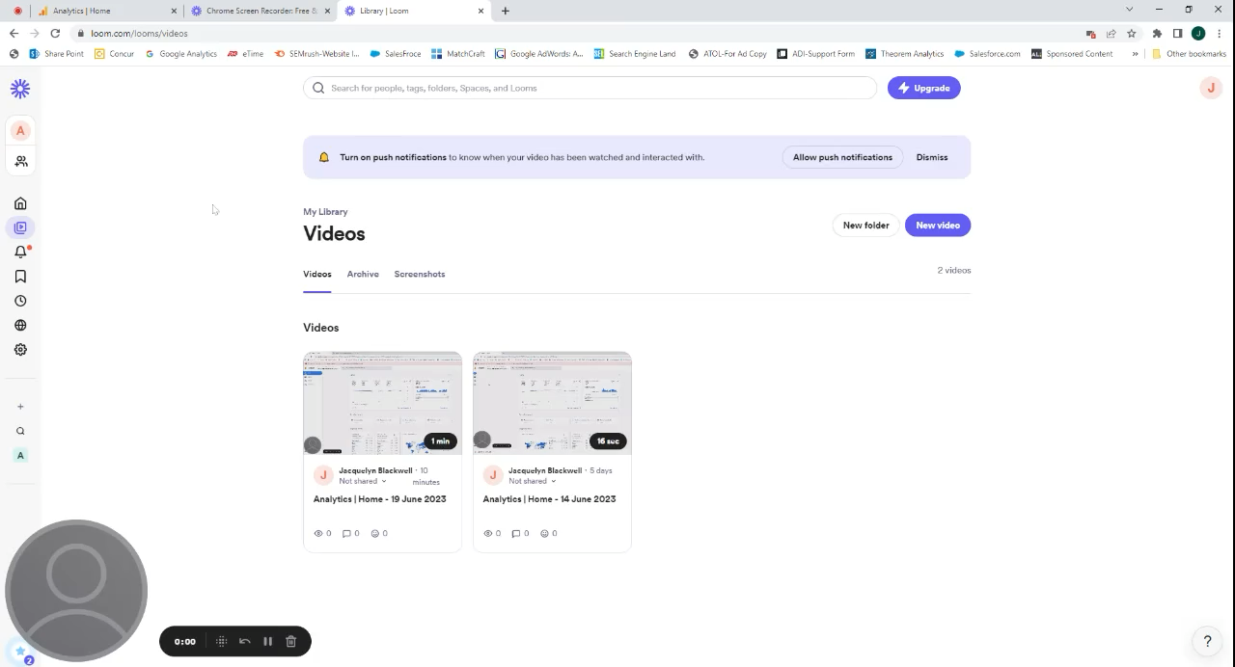
GA4 terminology
Events
Universal Analytics had events too,
but they’re totally different in GA4.
Any engagement with your site is now called an event, including page views.
In Universal Analytics, interactions were tracked as “hits”. Now they’re all events. GA4 has automatic, recommended, and custom events.
Events can further be labeled as conversions, but everything is an event first.

Slide 9
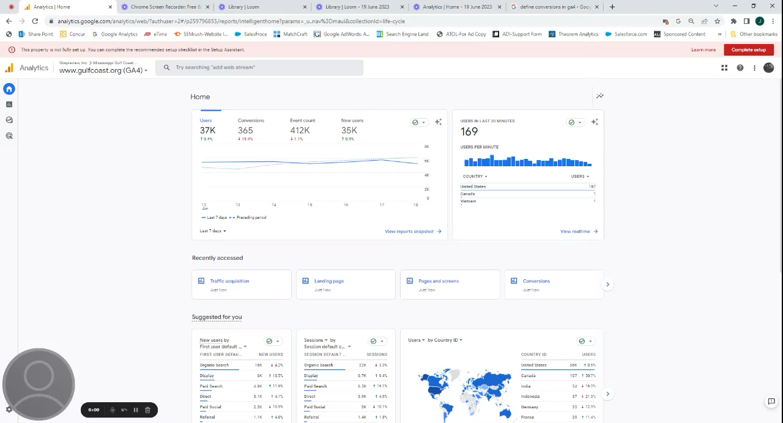
GA4 terminology
Conversions
A conversion is any user action that's valuable to your business; for example, a user purchasing from your store or subscribing to your newsletter are examples of common conversions.

Slide 10
Conversion tracking
Conversions in GA4 must first be created as an event, then enabled as a conversion.
This is a great opportunity to review goal completions with your team/agency
and ensure that you are tracking what is most important.
It’s important to remember your conversions impact your engagement rate.
  If the ‘hotels’ pageview is a conversion, and your campaign is clicking through
  to that page, it would have a 100% engagement rate.
  Think about having only activation conversions—submitting a contact form,
  booking a reservation or room, requesting a visitor guide, etcetera.

Slide 11
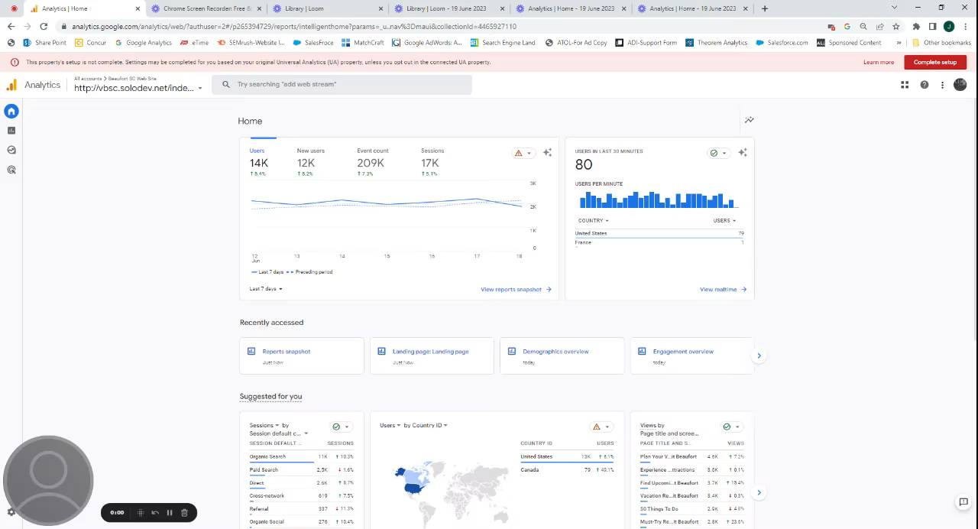
GA4 terminology
Analytics | Home - 19 June 2023 - Watch Video
Custom Reports
Create specific reports that you regularly want to report on for quick and easy access.

Slide 12
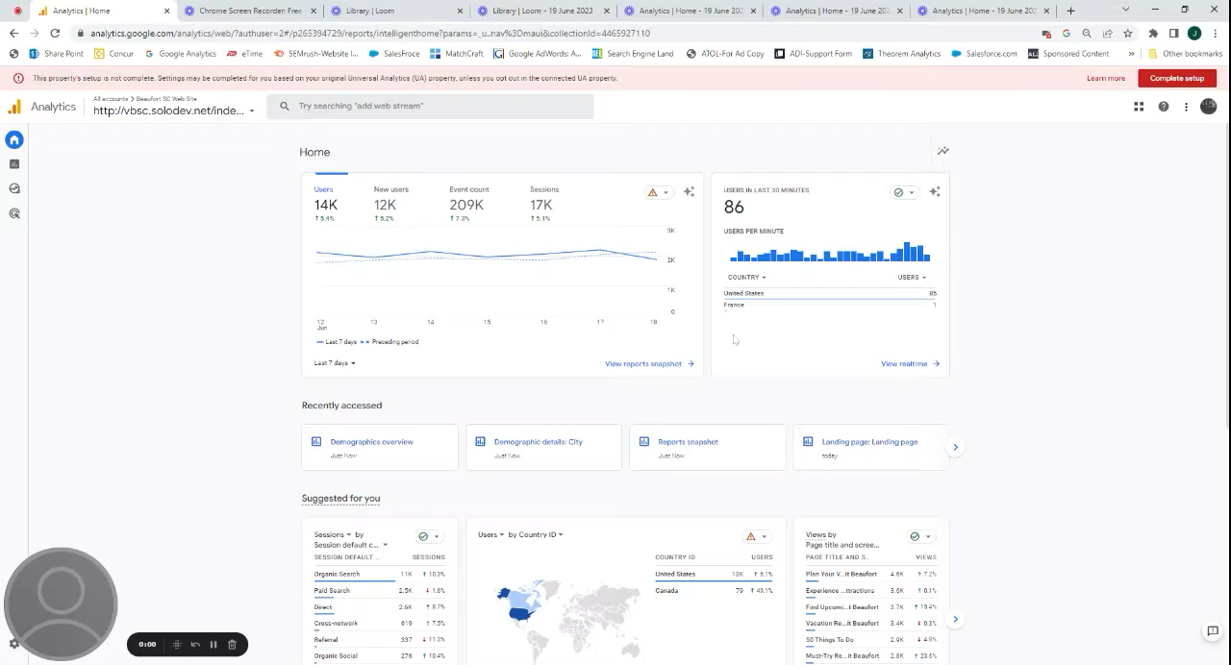
GA4 terminology
Analytics | Home - 19 June 2023 - Watch Video
Demographics
The Demographic details report provides key characteristics about the people who use a website or app, including a user's language, interests, location, age, and gender. Only aggregated data from users who consent to sharing demographics data are included in the report.

Slide 13
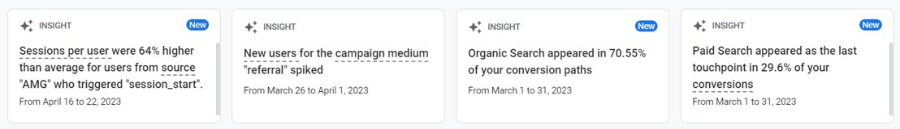
Insights from GA4
Insights will begin to populate after enough data has been collected to infer upon.
In 3/4 of the insights, Google highlighted campaigns (social, organic, and paid search).

Slide 14
Key Takeaways
If you or your agency have not created GA4 yet, create immediately and back up your UA data.
Remember, we are all learning and benchmarks for success are only just now being decided.
If knowing how your website is performing is essential to your role—log into GA4 every day.
You or your agency should be updating UTMs.
Set up proper conversions and additional events on for your site.
Set proper expectations with your team and stakeholders.
Monitor data closely to better understand your website user’s behavior.

Slide 15

Questions?

Slide 16
Thank you!

